Slide 1

DACQ Study Guide: December 2007
ART HISTORY I

Slide 2
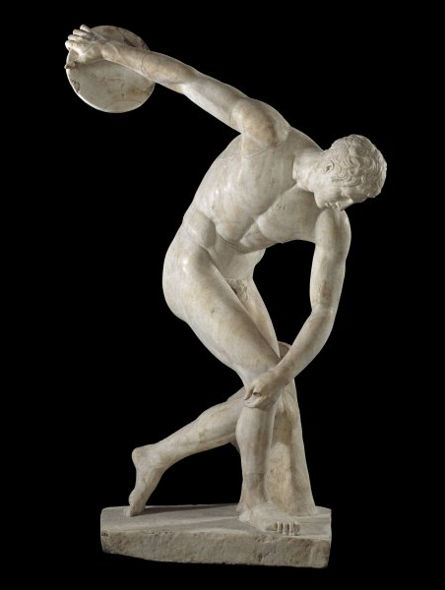
“The Discus Thrower” (Discobolos) by Myron. c. 460 b.c., marble sculpture
One of the first sculpture's to achieve rhythmos, the balanced depiction of motion. Sometimes given the epithet “Palombara” after the location of its discovery on a Roman hill. Several marble copies of the lost original bronze exist, with the most famous once being misidentified by Monnot as the Wounded Gladiator.

Slide 3
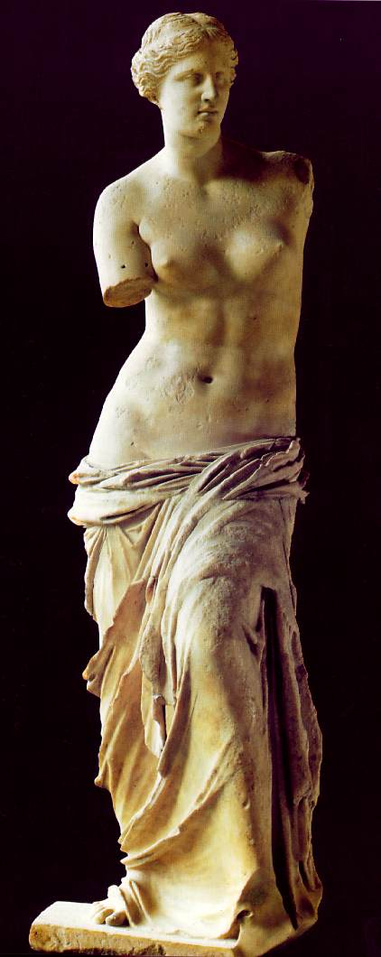
“Venus de Milo” (artist unknown).
c. 150 b.c., marble sculpture
As its name suggests, found on the Greek island of Milos by a peasant named Yorgos. Generally theorized that one arm was draped across the figure's stomach to hold up the sheet, while the other held an apple or possibly even a shield. Though its true artists is unknown, Alexander of Antioch is the most likely candidate.

Slide 4
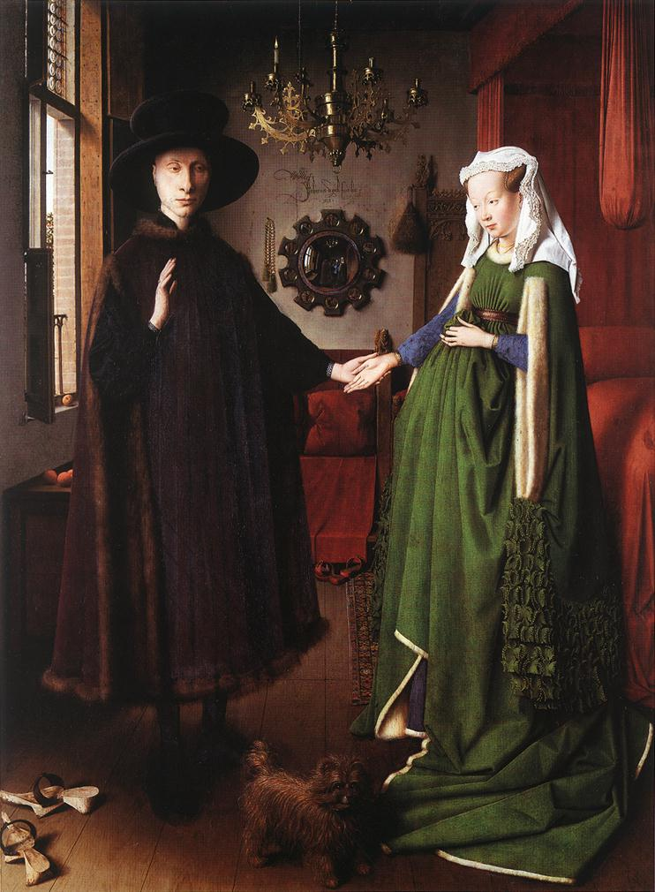
“The Arnolfini Wedding” by Jan van Eyck. 1434, oil on wood
Possibly painted chiefly as a testament to the marriage of Arnolfini and Giovanna Cenami, the reason for the signature and the convex mirror. Symbols of marriage include the dog, cherries, Giovanna's clothing, bed, single candle, mirror, and shoes, which are cast aside on the now-blessed ground.

Slide 5
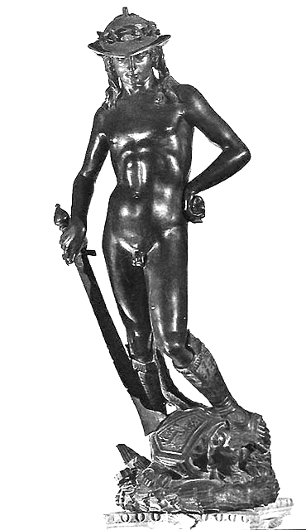
“David” by Donatello.
c. 1440, bronze sculpture
Famous for being the first free-standing nude since antiquity. Created as an emulation of classical design, particularly the contraposto pose of the subject. Can be quickly distinguished from other “David” sculptures by subject's femininity, hat, sword in right hand., severed head of Goliath. Commissioned by Cosimo d'Medici.

Slide 6
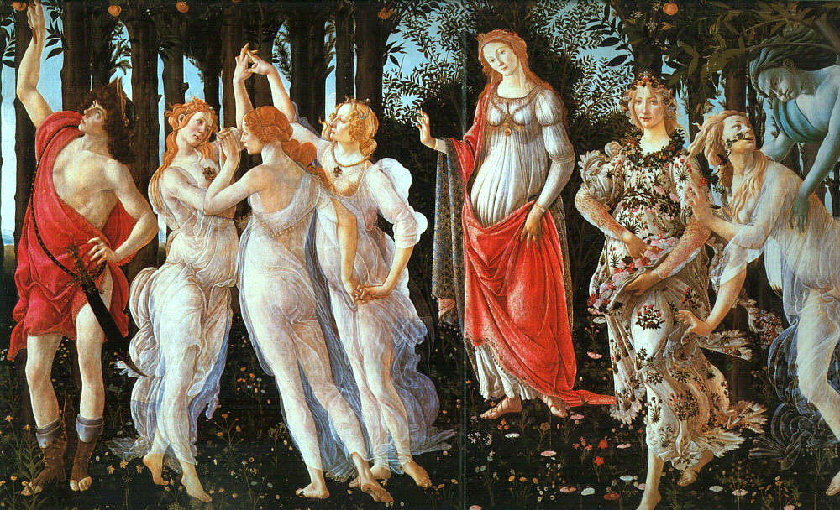
“Primavera” by Sandro Botticelli. c. 1478, tempera on wood
Often anglicized as “The Allegory of Spring. Depicts (L-R): Mercury, the Graces, Venus, Flora, Chloris being lusted after by Zephyrus. Fruit in trees may be a reference to the Garden of the Hesperides.

Slide 7
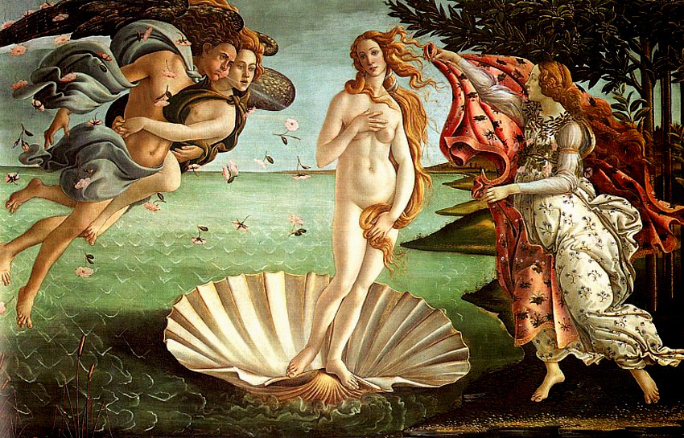
“The Birth of Venus” by Sandro Botticelli. 1480, tempera on canvas
One of the first renaissance works to depict pagan mythology, it was almost burned by Savonarola. Shows Venus, two Zephyrs, and a Horae and is set off the coast of Cyprus.

Slide 8
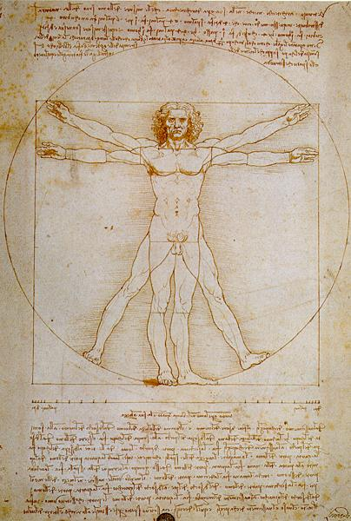
“Vitruvian Man” by Leonardo da Vinci. c. 1490, pen, ink, and watercolor
Alternatively known as the “canon of proportions.” Sketch appearing in one of Leonardo's notebooks demonstrating his theories of form. Based on the research of Vitruvius, a Roman polymath.

Slide 9
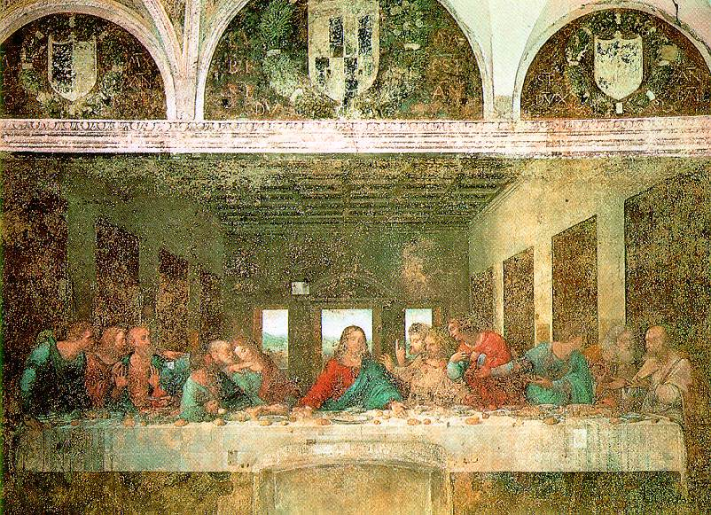
“The Last Supper” by Leonardo da Vinci. 1498, fresco
Located in the Santa Maria delle Grazie in Milan (commissioned by Ludovico il Moro of the Sforza family). Horribly beat up – weathered, slightly bombed, and once had a doorway cut through it.

Slide 10
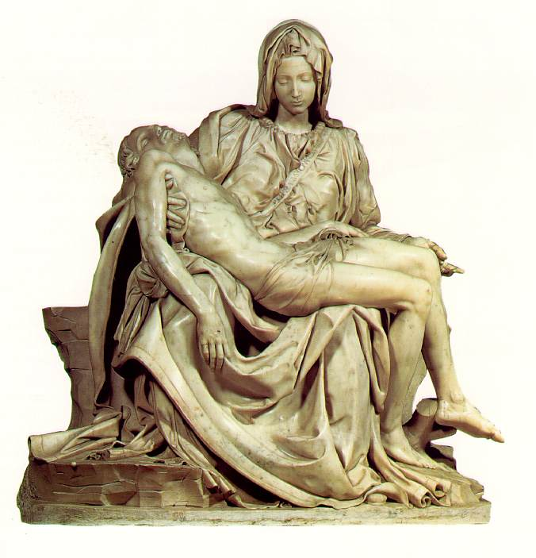
“Pietà” by Michelangelo Buonarotti. 1498-1500, marble sculpture
Michaelangelo's first masterpiece is the most famous of all Pieta works (depictions of Mary holding Jesus's body). The only work signed by Michaelangelo (on Mary's sash), he slipped in during the night to carve his name after another artist was rumored to have created the work.

Slide 11
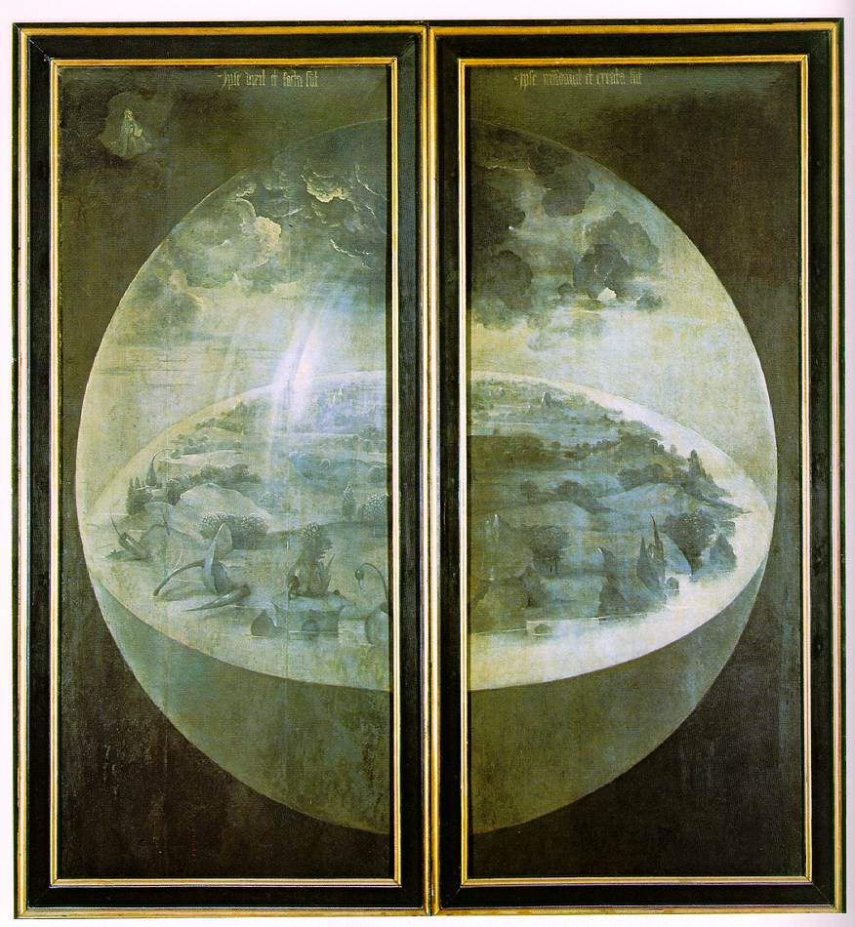
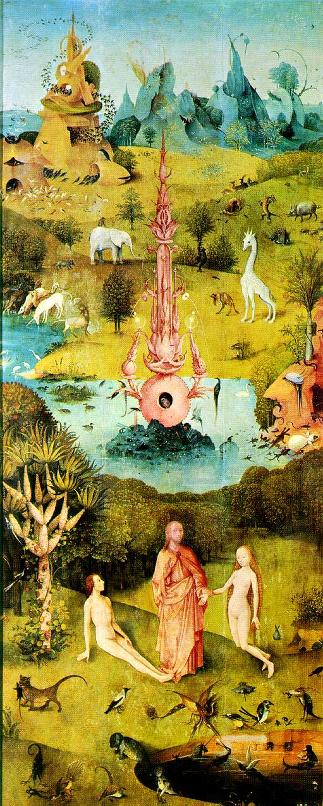
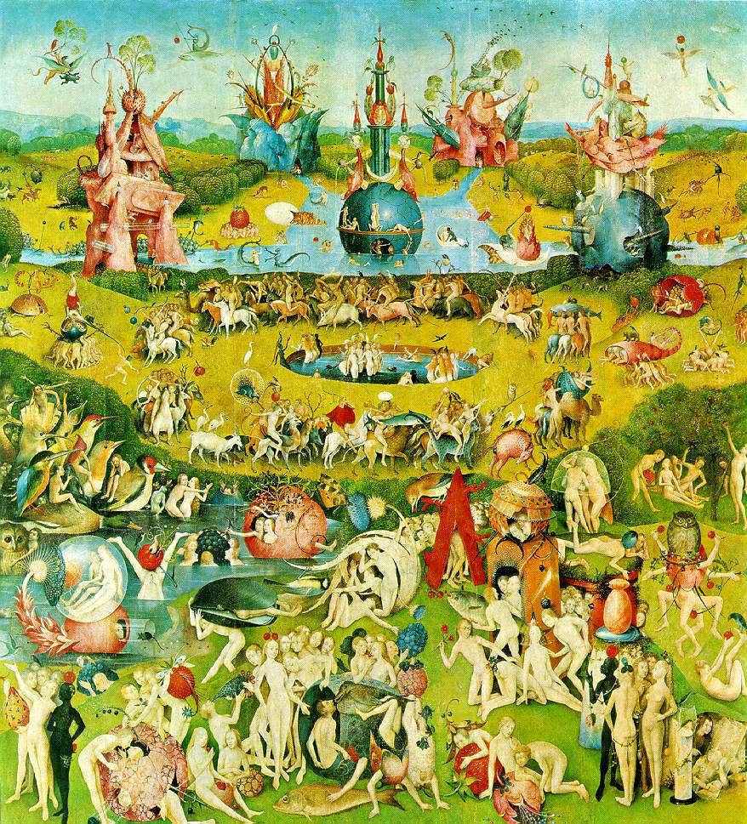
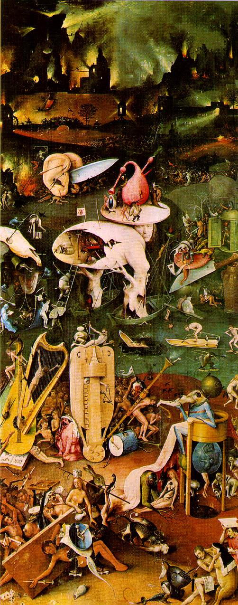
“The Garden of Earthly Delights” by Hieronymous Bosch. c. 1500, oil on panel
Famous Dutch Triptych that depicts the Garden of Eden on the left panel, the present world of sin at center, and the torments of hell at right. When closed, depicts the creation of the Earth. Often cited as a forerunner of
Surrealism. It is not difficult to see why.

Slide 12
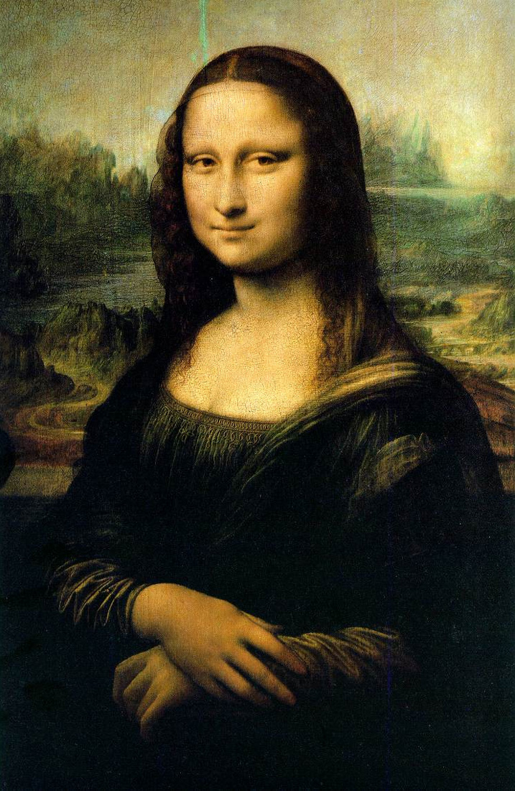
“Mona Lisa” by Leonardo da Vinci. 1503-1506, oil on wood
Iconic painting of the high renaissance, demonstrating Leonardo's mastery of the sfumato technique of blending paint layers to create volume and depth. Currently housed in the Louvre, stolen in 1911 and recovered in a hotel room. Also called “La Gioconda” after its supposed subject, a merchant's wife, though theories abound as to its true subject, which might be a feminized Leonardo.

Slide 13
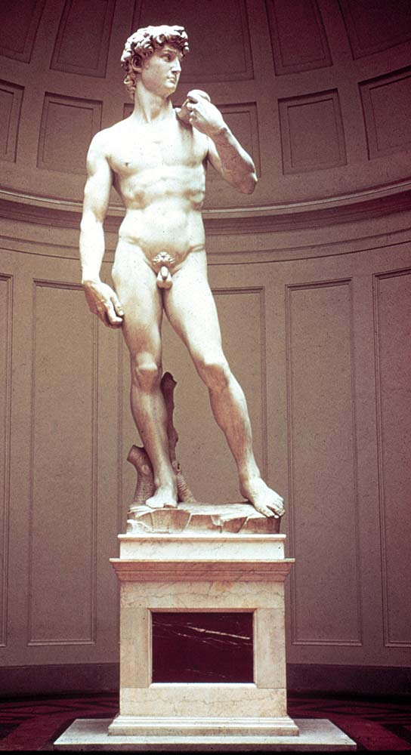
“David” by Michelangelo Buonarotti. 1501-1504, marble sculpture
Famous sculpture was completed after Agostino de Duccio abandoned a huge slab of marble after failing to create a similar image. Prime example of contraposto, can be distinguished form other “David” sculptures by its youthful, innocent depiction of the figure. Supplanted Donatello's “Judith and Holofernes” at the entrance to the Palazzo Vecchio, though it is now housed at the Accademia Gallery.

Slide 14
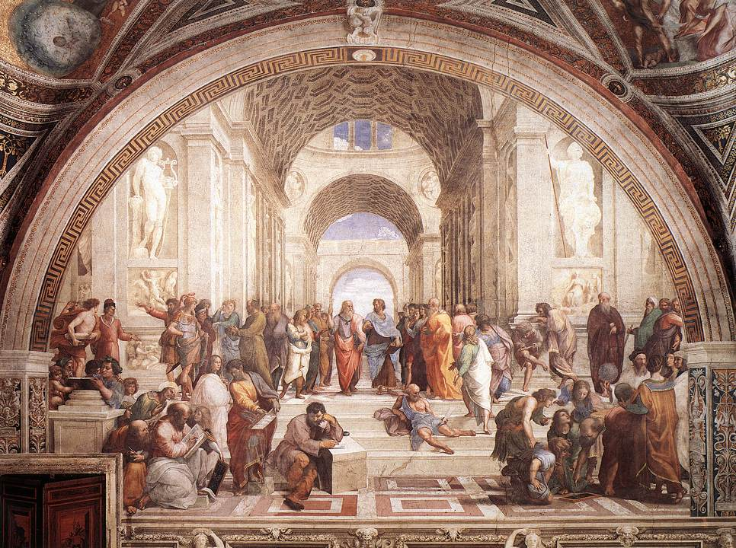
“The School of Athens” by Raphael. 1509-1511, fresco
Depicts Plato and Aristotle in the center, including Euclid, Pythagoras, Socrates, and Raphael himself. Notably, many of the artist's contemporaries, including Bramante, Michelangelo, and Leonardo, inspired the depiction of the thinkers. Located in the Vatican between “La Disputa” and “Parnassus.”

Slide 15
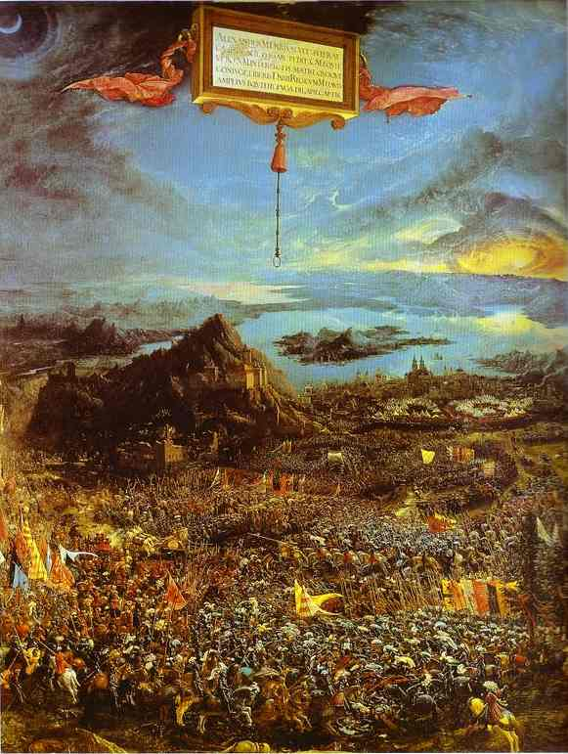
“Alexander’s Victory (The Battle at the Issus)” by Albrecht Altdorfer. 1529, oil tempera on wood
Famous for being one of the first works to depict a historical battle, though it does so poorly (setting the clash between Alexander the Great and Darius III in the Alps in front of several German cities and dressing the participants in sixteenth century armor).

Slide 16
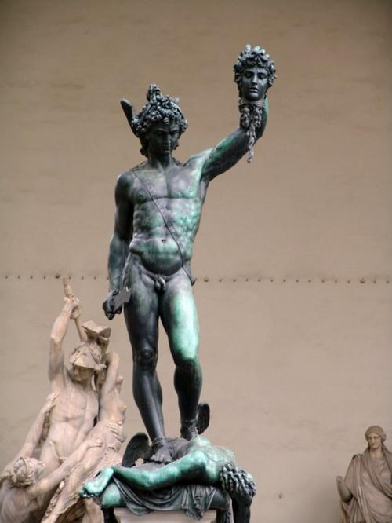
“Perseus with the Head of Medusa” by Benvenuto Cellini. 1563, bronze sculpture
Sometimes cited as a transition from Late Renaissance to Mannerism. Notable for its ornate base, which depicts a scene of Perseus with Andromeda. Commissioned by Cosimo d'Medici.

Slide 17
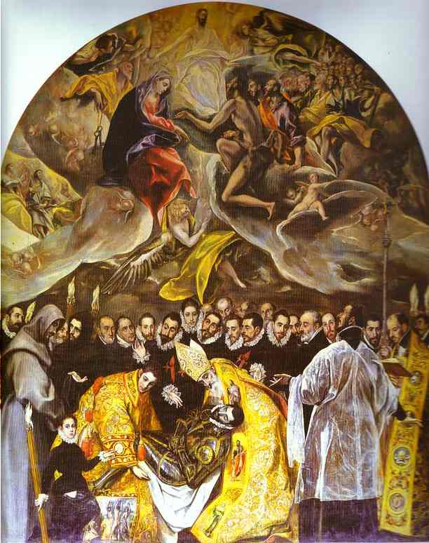
“The Burial of Count Orgaz” by El Greco. 1586, oil on canvas
Housed in Santo Tome in Toledo, Spain. Depicts local legend in which Saint Stephen and Saint Augstine buried Don Gonzelz Ruiz of Orgaz. Notably depicts Andres Nunez, the comissioner, El Greco, and El Greco's son Jorge Manuel as figures in the background. Major work of Mannerism.

Slide 18
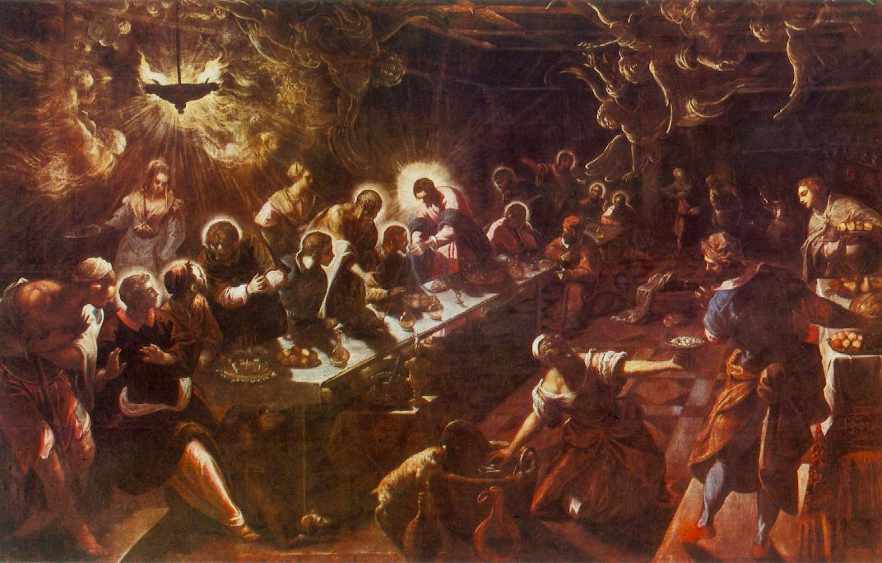
“The Last Supper” by Tintoretto. 1592-1594, oil on canvas
Vibrant, almost surreal depiction of angels typical of Tintoretto's work, earned him nickname “Il Furioso.” Located in San Giorgio Maggiore in Venice, along with Tintoretto's “Harvest of Manna.”

Slide 19
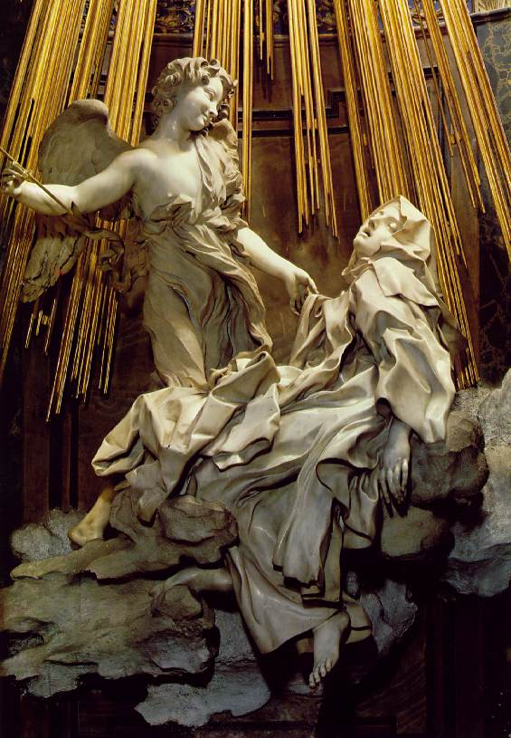
“The Ecstasy of Saint Teresa” by Gianlorenzo Bernini. 1646-1652, marble sculpture
Often cited as an ideal synthesis of painting, sculpture, and architecture. Depicts Saint Teresa on a cloud, being pierced with a golden spear by angels (generally considered to be sexual imagery). Housed in the Cornaro Chapel of Santa Maria della Vittoria in Rome.

Slide 20
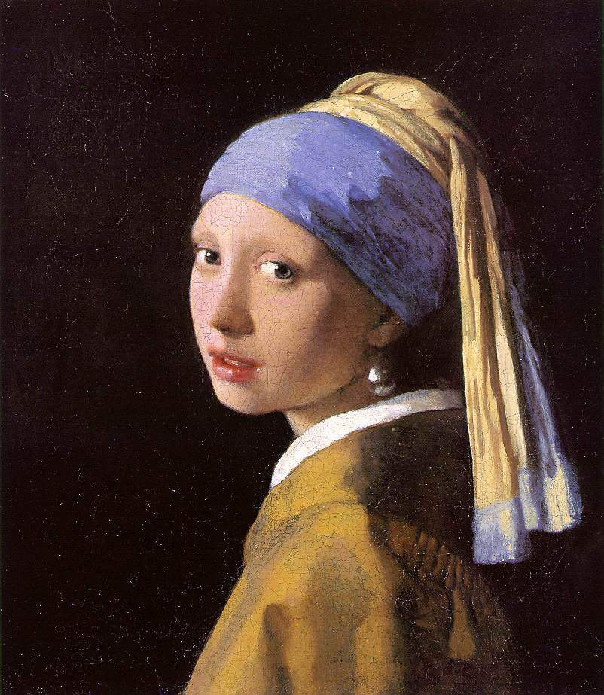
“The Girl with a Pearl Earring” by Johannes Vermeer.
c. 1665-1667, oil on canvas
Notable for inspiring the historical novel of the same name by Tracy Chevalier (later made into a film). Often called “the Mona Lisa of the North.” Recently underwent major restoration project, which showed enhanced details of clothing, facial expression.

